Slide 1
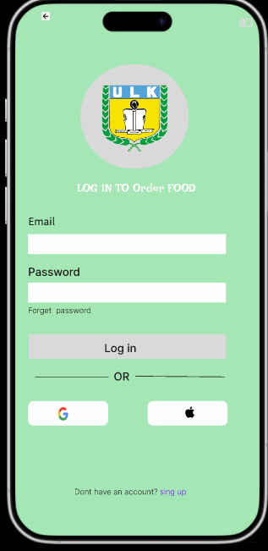
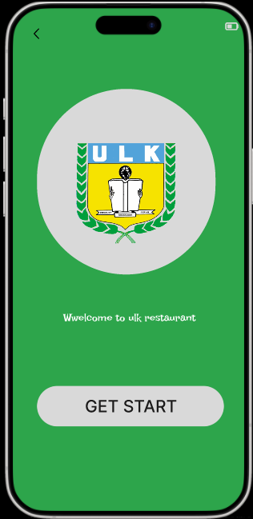
Ulk cafeteria online ordering system

Slide 2
Starting
the design
Paper wireframes
Digital wireframes
Low-fidelity prototype
Usability studies

Slide 3
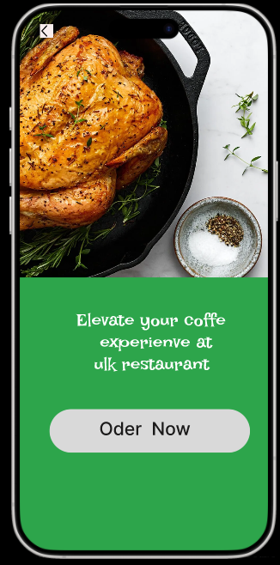
Project overviewp
This project is about creating a web application that allows university students to order food and drinks online from the cafeteria instead of waiting in line. The system helps students save time, avoid long queues, and easily access the menu from their uration:

Slide 4
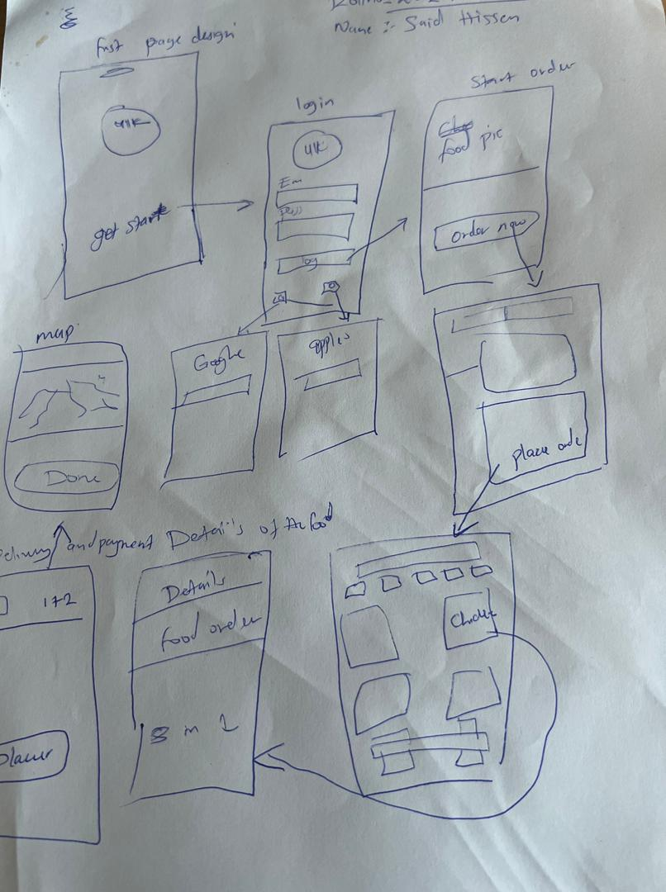
Before creating the digital design, a paper wireframe was drawn to show the layout and structure of the web application. It helped visualize how users will navigate the cafeteria ordering system and how each screen connects.
The wireframe includes
: • Home Page: shows menu categories and navigation options.
• Menu Page: displays food and drink items with prices and “Add to Cart” buttons.
C:\Users\NYAYIK\AppData\Roaming\Microsoft\Windows\Network Shortcuts\Presentation1 said hissen.pptx

Slide 5
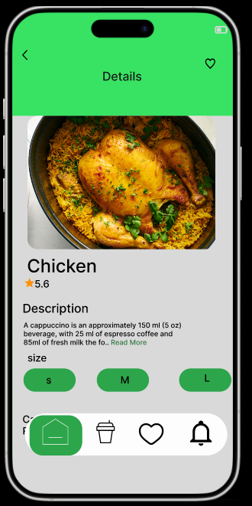
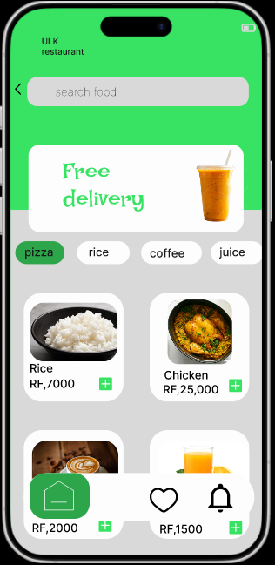
Problem Statement
:Students often face long queues and delays when ordering food from the university cafeteria, especially during lunch hours. This leads to wasted time, frustration, and sometimes missing classes. The current manual system also makes it hard to track orders or check menu availability in real time.
Project Goals/Objectives:
1. To reduce waiting time by allowing students to place orders online.
2. To make the ordering process easier and faster through a user-friendly web interface.

Slide 6
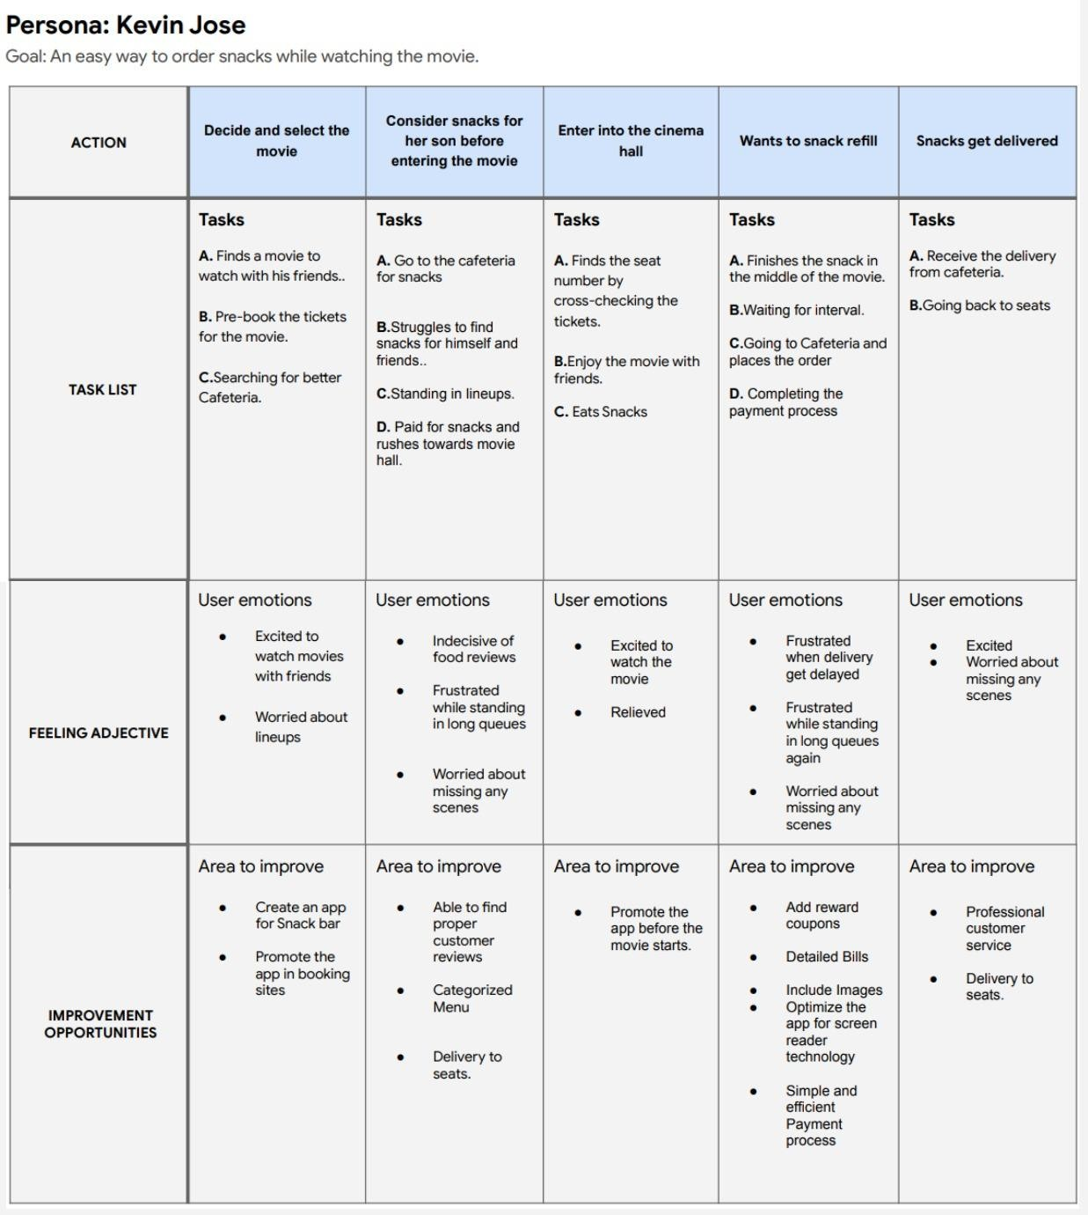
User journey map
Mapping Kevin’s User journey revealed how helpful it would be for users to have access to dedicated “Relish App”(a snack ordering app).

Slide 7


User research: summary
I conducted interviews and created empathy map to focus on understanding user behaviour,their needs through observations and collecting feedbacks.
A primary user group identiﬁed through research was adults who don’t want to spent lot
of time for snack ordering .Other problems faced by them are missing some part of the movie, limited access to menu,etc..

Slide 8
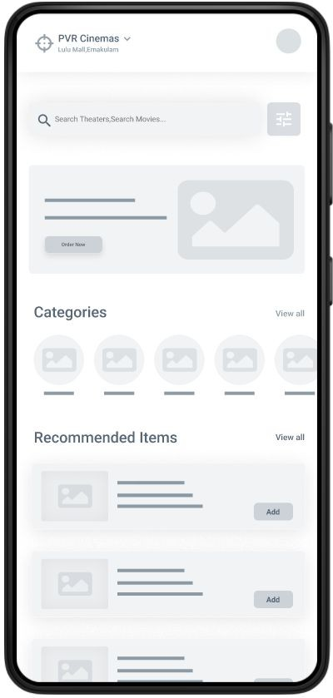
Digital wireframes
Proceeding towards digital wireframes i want to ensure the findings and feedbacks from the user research were covered.
User can easily
choose their
favourites snacks from the categorized menu section.
The Add button
make it fast
and easy for users to order

Slide 9
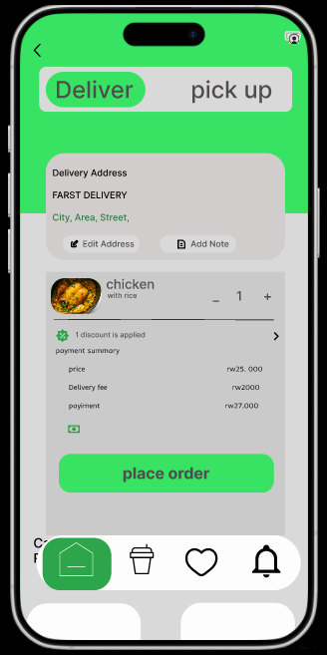
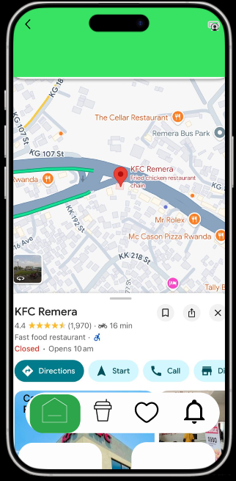
Mockups
Before usability study
After usability study
Before the usability study 2 the main ﬂow was user have to complete the scheduling by selecting movie time,date and pickup option to get into the snack home page.
After the usability study I added the pickup options to the starting of checkout process to avoid the confusions faced by the users to get into the snack home page.

Slide 10
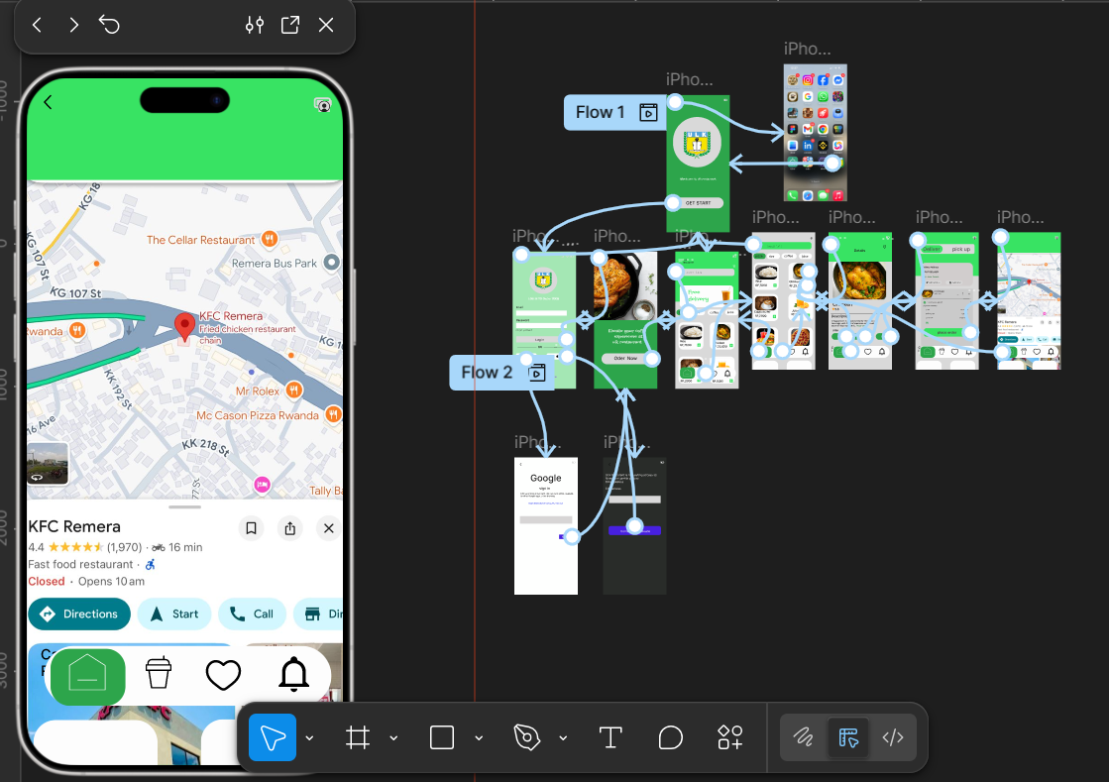
Low-ﬁdelity prototype
The low-ﬁdelity prototype connected to the primary ﬂow of the app.
View Prototype :Low fidelity (Relish App)

Slide 11

The ﬁnal high ﬁdelity prototype presented with a main user ﬂow contains adding snacks, scheduling on-seat delivery and the tracking process.
View Prototype : High fidelity (Relish App)

Slide 12
Key Mockups

